Slide 1
Noisy channel model of spelling
Notes:
Welcome back!
In the last two videos of this modules, we understood about spelling correction, its applications, and different types of spelling errors. In this video, we will look at a model which is most widely used for spelling correction which is the noisy channel model of spelling.

Slide 2
Noisy channel model of spelling
Probabilistic model
Notes:
This is a probabilistic model.

Slide 3
Noisy channel model of spelling
Probabilistic model
Given a misspelled word x, it finds the correct word w
Notes:
And the aim of this model is to find the correct word w, given a misspelled word x.

Slide 4
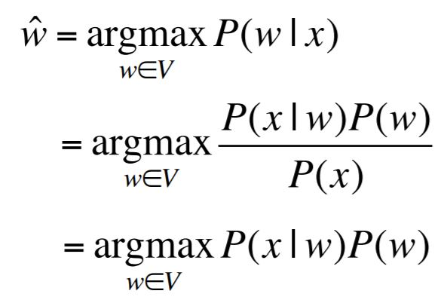
Noisy channel model of spelling
Probabilistic model
Given a misspelled word x, it finds the correct word w
Notes:
As mentioned, it is a probabilistic model, it finds the probability of the correct word w, given a misspelled word x.
We find this probability for a set of candidate words and whichever word maximizes the probability is the output of this model.

Slide 5
Noisy channel model of spelling
Probabilistic model
Given a misspelled word x, it finds the correct word w
Notes:
We know that this probability can be represented as shown here. We have already covered this in the language modeling module.
So, the probability of w given x is equal to the probability of x given w multiplied with the probability of w and divide by the probability of x.

Slide 6
Noisy channel model of spelling
Probabilistic model
Given a misspelled word x, it finds the correct word w
Notes:
And the P of x or the probability of a misspelled word will remain the same for each candidate of that word and hence it will be a constant. So, we can remove that from the denominator.
The noisy channel model of spelling maximizes this probability.

Slide 7
Noisy channel model of spelling
Probabilistic model
Given a misspelled word x, it finds the correct word w
P(w) -> Language Model
Notes:
Here, we calculate the probability of candidate word or the P of w using a language model

Slide 8
Noisy channel model of spelling
Probabilistic model
Given a misspelled word x, it finds the correct word w
P(w) -> Language Model
P(x|w) -> Channel Model
Notes:
And the probability of x given w is the actual channel model. It is also referred to as the error model.
So, this is actually what the noisy maximizes to get the output.
Let me now break down each step of this algorithm that will give you a better understanding of how spelling correction actually works.

Slide 9
Steps of Noisy channel model of spelling
Generate candidate words
Notes:
The first step is to generate the candidate words. So, for each input word, we have to generate the candidates.

Slide 10
Steps of Noisy channel model of spelling
Generate candidate words
Words with similar spelling
Notes:
And the simplest way to generate these candidates will be to generate words with similar spelling.
Now the question is how do we find the words with similar spelling?
If you recall, in the string similarity module of this course, we covered the edit distance. The aim there was to find the similarity between strings.

Slide 11
Steps of Noisy channel model of spelling
Generate candidate words
Words with similar spelling
Words having small edit distance
Notes:
We can use that edit distance to generate the candidates having similar spelling. So, the words having small edit distance with the input word will be our candidate word.

Slide 12
Steps of Noisy channel model of spelling
Generate candidate words
Words with similar spelling
Words having small edit distance
Insertion, Deletion, Substitution
Notes:
And these were the different edits that we covered. Insertion, deletion and substitution.

Slide 13
Steps of Noisy channel model of spelling
Generate candidate words
Words with similar spelling
Words having small edit distance
Insertion, Deletion, Substitution, Transposition of two adjacent letters
Notes:
There is one more type of edit which is used commonly which is the transposition of two adjacent letters. All these edits are used to generate the candidate words. And this is also known as Damerau Levenshtein edit distance.
So, all the words which have smaller edit distance with the input word are our candidate words.
This completes the first step of noisy channel model. We now have our candidate words.

Slide 14
Steps of Noisy channel model of spelling
Generate candidate words
Language Model
Notes:
Next, we use the language model to generate the probabilities.

Slide 15
Steps of Noisy channel model of spelling
Generate candidate words
Language Model
Probability of occurrence of each candidate word
Notes:
Using language model, we calculate the probability of occurrence of each candidate word.

Slide 16
Steps of Noisy channel model of spelling
Generate candidate words
Language Model
Probability of occurrence of each candidate word
Can use unigram, bigram, trigram, or any N-gram language model
Notes:
And we can use any language model, either the unigram, or bigram, or trigram, or any other.

Slide 17
Steps of Noisy channel model of spelling
Generate candidate words
Language Model
Probability of occurrence of each candidate word
Can use unigram, bigram, trigram, or any N-gram language model
Notes:
So, this language model will give us the probability of each candidate word.
This completes the second step.

Slide 18
Steps of Noisy channel model of spelling
Generate candidate words
Language Model
Channel Model
Notes:
Next, we use the channel model or the error model

Slide 19
Steps of Noisy channel model of spelling
Generate candidate words
Language Model
Channel Model
Notes:
And calculate the probability of x given w.
We saw that there are 4 different types of edits that we use to generate candidates.

Slide 20
Steps of Noisy channel model of spelling
Generate candidate words
Language Model
Channel Model
del [x,y] : Count(xy typed as x)
Notes:
The first one is the deletion, and hence we count how many times xy is types as x, or y is deleted.

Slide 21
Steps of Noisy channel model of spelling
Generate candidate words
Language Model
Channel Model
del [x,y] : Count(xy typed as x)
ins [x,y] : Count(x typed as xy)
Notes:
Next is the insertion. So, we count how many times x is type as xy, or y is deleted.

Slide 22
Steps of Noisy channel model of spelling
Generate candidate words
Language Model
Channel Model
del [x,y] : Count(xy typed as x)
ins [x,y] : Count(x typed as xy)
sub [x,y] : Count(x typed as y)
Notes:
Sub of x and y means counting how many times x is typed as y

Slide 23
Steps of Noisy channel model of spelling
Generate candidate words
Language Model
Channel Model
del [x,y] : Count(xy typed as x)
ins [x,y] : Count(x typed as xy)
sub [x,y] : Count(x typed as y)
trans [x,y] : Count(xy typed as yx)
Notes:
And finally, trans x y is the count of times xy is types as ys.
So, we create a confusion matrix for each of the edit which tells us the count for each pair of x and y. Once we have these counts, we build the channel model or the error model.

Slide 24
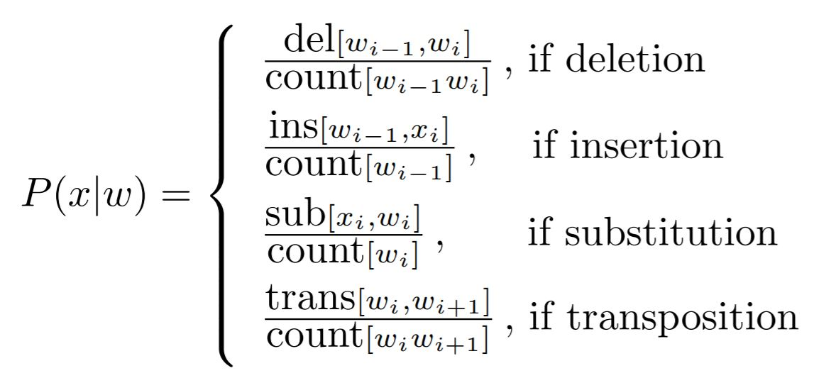
Steps of Noisy channel model of spelling
Generate candidate words
Language Model
Channel Model
Notes:
P of x given w is equal to the count of times w i is deleted from the word w i-1 w i, divided by the count of times w i-1 w i occurs together, in case the edit is deletion.

Slide 25
Steps of Noisy channel model of spelling
Generate candidate words
Language Model
Channel Model
Notes:
Or, it is equal to the count of times x i is inserted after w i - 1 divided by the count of times w i - 1 occurred, in case of insertion

Slide 26
Steps of Noisy channel model of spelling
Generate candidate words
Language Model
Channel Model
Notes:
Or if the edit is substitution, we calculate the count of times x i is typed as w i divided by the count of times w i occurred

Slide 27
Steps of Noisy channel model of spelling
Generate candidate words
Language Model
Channel Model
Notes:
And finally, if the edit is transposition, the probability is equal to the count of times w i w i+1 is typed as w i+1 w i, divided by the count of times w i w i+1 occurred together.
This is how we compute the channel model. And note that, to find these probabilities, we must have the confusion matrix for each of the edits, otherwise we will not be able to find the respective counts.
There are some pre-calculated confusion matrices which can be used here. However, in the project which we will solve, we will look at an alternative approach where we will not need these confusion matrices. Don’t worry about this step as we will cover it in the next video.
So, this completes the third step of noisy channel model

Slide 28
Steps of Noisy channel model of spelling
Generate candidate words
Language Model
Channel Model
Probability of the word
Notes:
Finally, in the fourth step, we calculate the probability of the word

Slide 29
Steps of Noisy channel model of spelling
Generate candidate words
Language Model
Channel Model
Probability of the word
For each candidate word
Notes:
Here, for each candidate word

Slide 30
Steps of Noisy channel model of spelling
Generate candidate words
Language Model
Channel Model
Probability of the word
For each candidate word
Product of the output of language model and channel model
Notes:
We compute the product of the output of the language model and the channel model

Slide 31
Steps of Noisy channel model of spelling
Generate candidate words
Language Model
Channel Model
Probability of the word
For each candidate word
Product of the output of language model and channel model
Notes:
Finally, we take the argmax of the outputs and that returns the most accurate candidate word with respect to the input word.
So, this is how the noisy channel model works. To summarize, in noisy channel model of spelling, we start with generating the candidate words using the edits, then we use the language model and calculate the probability of occurrence of each of the candidate word, then using the channel model, we calculate the probability of the edits or the error. Finally, for each candidate word, we compute the product of the output from language model and channel model, and whichever candidate produce the maximum output is the correction for the input word.
Now, we know how the noisy channel model of spelling works. Let’s move on to the next video and build our auto correct model.

Slide 32
Thank You
Notes:
Thank you!!

